Slide 1
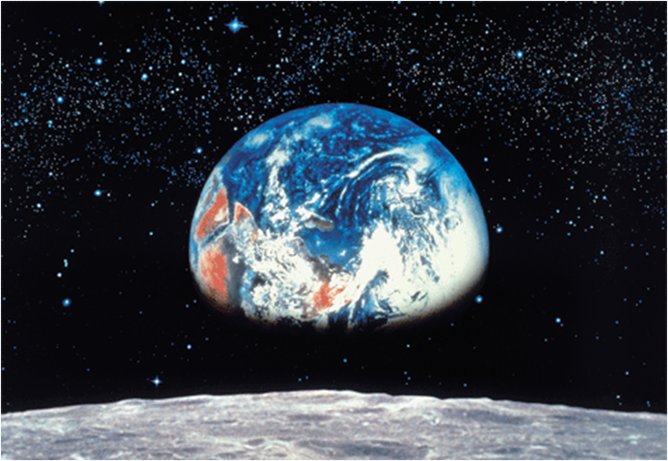
“A Tale of Two Rocks”
Concept: Informational Text – Science Article

Slide 2
Essential Question
How can readers determine the main idea of informational texts?
The main idea is a brief statement of what you think the author wants the reader to know after reading each paragraph or an entire nonfiction selection. Frequently, the author does not directly state the main idea, and readers must gather details to determine the implied concept.

Slide 3
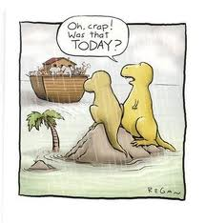
Background to the Text
What happened to the dinosaurs?
In your notes, quickly make a jot list based on your current knowledge of the dinosaurs’ extinction.
Many theories surround the extinction of the dinosaurs including asteroids and volcanoes. This text provides scientific evidence of a cataclysmic event where an asteroid hits near the Yucatan Peninsula in Mexico.

Slide 4
Informational Text
Informational text is a category of nonfiction that uses facts, statistics, and details to inform readers on a specific topic or issue.
This information article demonstrates how evidence collected by scientists in various fields can combine to explain events in the past.

Slide 5
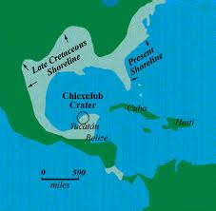
Chicxulub Crater
Most scientists now agree that the large crater off the coast of Mexico resulted from the asteroid that killed the dinosaurs approximately 65 million years ago.

Slide 6
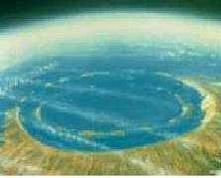
Media Coverage
This first video is a short BBC report about the scientific discoveries concerning Chicxulub. Many of the facts directly relate to the informational text used in the lesson.
http://www.youtube.com/watch?v=Czo9cjlpkZU

Slide 7
Media Coverage
This second video presents a more scientific explanation and even mentions one of the scientists in our selection. However, notice the differences between this report and the “news” report. Be prepared to compare them following the video.
http://www.youtube.com/watch?v=0EyDd7rZWnE

Slide 8
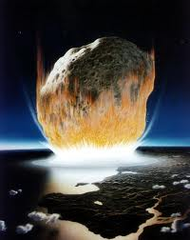
Jargon
Jargon is specialized vocabulary that members of a particular profession or group use.
It makes writing more specific and authentic, but it can also make an informational article hard to read.
Some examples from the text include sediment, magnetometer, pulverized, and anomalous.

Slide 9
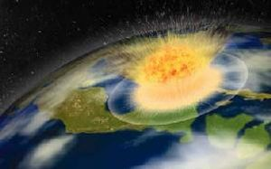
Reading the Text
As we read the text, think about the thesis of the article, the main idea that the author is trying to convey.
Be prepared to discuss the thesis and the supporting details listed throughout the article.

Slide 10
Post-Read Activity
Thesis
According to many scientists, the impact of the asteroid was the catalyst for “the sudden birth of a very different world.”
Find three specific details from the text to support this idea.
Write the thesis and the specific details in your notes.

Slide 11
Making Inferences
The author of this text infers that humans and other large mammals wouldn’t have evolved if dinosaurs hadn’t become extinct.
Do you agree with this reasoning?
Why or why not?
Use examples from the text as support.

