Slide 1
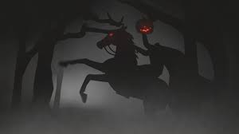
“The Legend of sleepy hollow”
Author: Washington Irving
Focus: Understanding Legends and the Mood of a Play

Slide 2
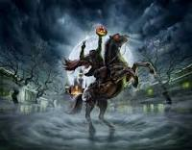
Background video and quiz
Go to your Language Arts Google Classroom page and select the assignment for “The Legend of Sleepy Hollow” as preparation for this lesson.
https://classroom.google.com/

Slide 3
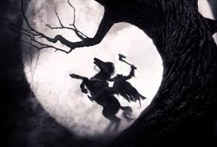
Essential Question #1
How can examining legends help readers understand history?
A legend is a story, which has some basis in truth that has been passed down from generation to generation, either through the oral or written tradition. Most legends represent an event or person that truly existed. Readers can examine the elements of the narrative and then research the legend to determine which elements contain a historically factual basis.

Slide 4
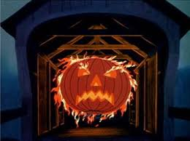
Essential Question #2
How can a reader analyze the mood of a drama/play?
Readers can look at the feelings created through the dialogue and actions of the characters as well as through the stage directions presented by the playwright. In a play, the actors themselves influence the mood through their interpretation and presentation of the drama.

Slide 5
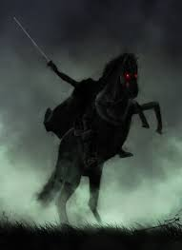
Legends: origins of the headless horseman
Most legends have their origins in truth, including the legend of the headless horseman.
Ghost of a Hessian soldier from the Revolutionary War, beheaded by a cannonball in some unnamed battle
Travels nightly in search of his head.
Possibly a local tale told to Irving when he lived along the Hudson River
Possibly old bit of folklore that actually preceded the Revolution passed down by the descendants of Dutch settlers.
Older European traditions, arguing that Irving was inspired by legends of the “Wild Huntsman,” a ghostly rider who terrified nighttime travelers with his pack of hounds in Medieval Germany.

Slide 6
http://www.theatreiv.org/guides/legend.pdf
Interesting Facts

Slide 7
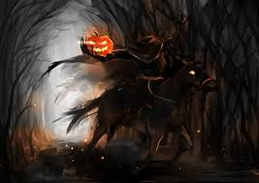
Headless Horseman in Pop culture
Pop Culture:
According to Wikipedia…
Popular culture or pop culture is the entirety of ideas, perspectives, attitudes, images, and other phenomena that are within the mainstream of a given culture, especially Western culture of the early to mid 20th century and the emerging global mainstream of the late 20th and early 21st century.
Heavily influenced by mass media, this collection of ideas permeates the everyday lives of the society. The most common pop culture categories are entertainment (movies, music, TV), sports, news (as in people/places in news), politics, fashion/clothes, technology and slang.
Popular culture is often viewed as being trivial and "dumbed down" in order to find consensual acceptance throughout the mainstream.

Slide 8
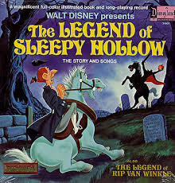
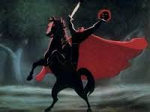
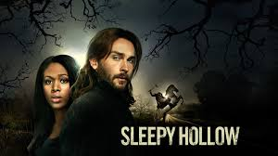
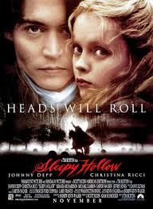
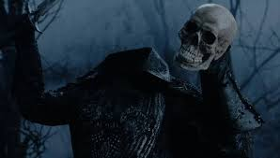
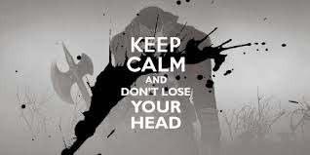
Headless Horseman in Pop culture
Film and TV Adaptations of the Original Text—

Slide 9
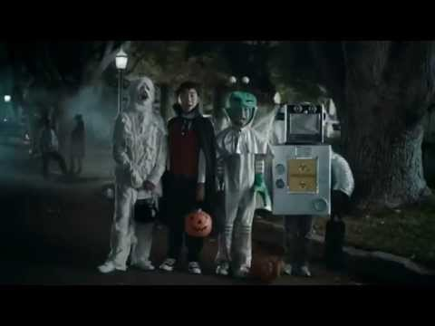
Headless Horseman in Pop Culture

Slide 10
Historical Connection~
If you lived in Sleepy Hollow in 1790, what would your life be like?
Open a new tab for the Internet, and go to my website. You will see a link to a blog for this lesson.
On the blog page, read the essay and respond to the question. Be sure to write in complete sentences and FULLY answer the question, citing evidence from the essay.

Slide 11
Reading the Play
Now, go to my website to the “Second Quarter” page. Scroll down until you see the document labeled “Sleepy Hollow Play.” Open that document in preparation to read.

Slide 12
Post-Reading Activities
Complete the activities on the guided reading handout for this text.

