Slide 1
Within Reach My Everest Story
Anchor Text Introduction
Author—Mark Pfetzer

Slide 2
Overview
In May 1996 the media scrambled to document the gripping story of sixteen-year-old Mark Pfetzer's expedition to Mount Everest. Not only was he the youngest climber ever to attempt the summit, he also witnessed the tragedy documented in Jon Krakauer's Into Thin Air, in which eight climbers perished in a sudden storm. Within Reach is Mark's extraordinary account of this experience and of his triumphs over several other challenging peaks. At once triumphant and tragic, this story is an inspiration to climbers, athletes, and armchair enthusiasts alike.

Slide 3
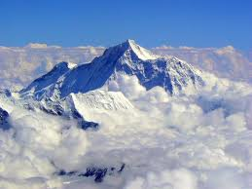
Mt. Everest
Height: 29, 029 feet
Approximately 5.5 miles high
Equivalent of approximately 20 Empire State Buildings

Slide 4
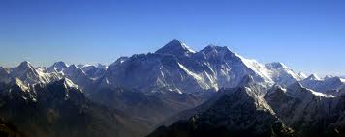
Mt. Everest
Mt. Everest is located on the border between Nepal and Tibet amid the Himalayan Mountains that extended through South Asia.

Slide 5
Facts about Mt. Everest
Tallest mountain in the world.
Number of people to attempt to climb Mt. Everest: approximately 4,000.
Number of people to successfully climb Mt. Everest: 660.
Number of people who have died trying to climb Mt. Everest: 142.
Named for: Sir George Everest, a British surveyor-general of India.
Age: approximately 60 million years old.
Other names: called "Chomolungma" by Tibetans and Sherpas, which means "Mother Goddess of the Earth."
Countries visible from the summit: Tibet, India, and Nepal.
First to climb to summit: Edmund Hillary and Tenzing Norgay on May 29, 1953.

Slide 6
Who is Mark Pfetzer?
Mountaineer
Motivational Speaker
Author
Survivor
OBJECTIVE: "To be the best I can be at what I do, and help others accomplish what they wish they could do. Pass my experiences on to today's younger generation, and prove to them that anything is obtainable if you try hard enough."

Slide 7
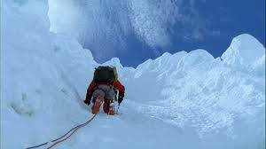
Adventure
In your opinion, what makes a good adventure story?
In your notes, make a list of the key features and explain why each one is important.

Slide 8
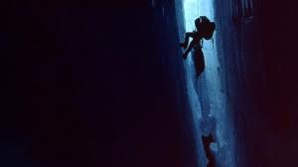
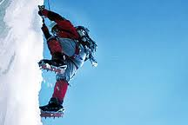
Risks
In this autobiographical text, a teenager attempts several very dangerous climbs to the summits of the world’s tallest mountains.
Based on your current knowledge, predict some of the risks and dangers he may have faced on his climbs.
Make a jot list in your notes.

Slide 9
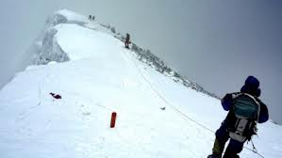
Survival
One theme that we will explore in this text is survival and the will to live while also achieving your dreams.
As we read, look for specific details that illustrate how many times Mark Pfetzer could have been killed trying to achieve his dreams.

Slide 10
Life or Death Choices
In this autobiography, Mark’s second attempt to summit on Mt. Everest occurs during a storm that resulted in the most deaths in two days on Mt. Everest.
Famous mountaineer and expedition leader from another climbing team, Rob Hall, died near the summit during the storm in May of 1996 because he wouldn’t leave one of his teammates/clients behind.
How far would you go to save your friend?
Would you risk your life for your friend?
Could you live with yourself if you left your friend to die?

Slide 11
Life or Death Choices
Listen to this interview by Dr. Ken Kamler, one of the climbers who experienced the 1996 storm and disaster. He was not on Mark Pfetzer’s climbing team; however, in base camp, all climbing teams know each other and work together. Mark Pfetzer, age 16, knew all of the individuals who were killed on Everest during those two days. This interview gives a better understanding of what it was like on the mountain.
http://www.youtube.com/watch?v=Bgqc2m7aBzs

Slide 12
Vocabulary Preview
This text contains very technical vocabulary about mountaineering and the topography/landscape of many of the locations where Mark Pfetzer climbed.

Slide 13
Climbing Terminology

Slide 14
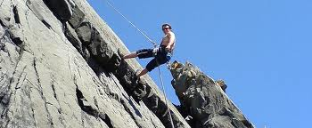
Abseil
To descend by means of a double rope attached to a firm anchor in the mountain (belay)

Slide 15
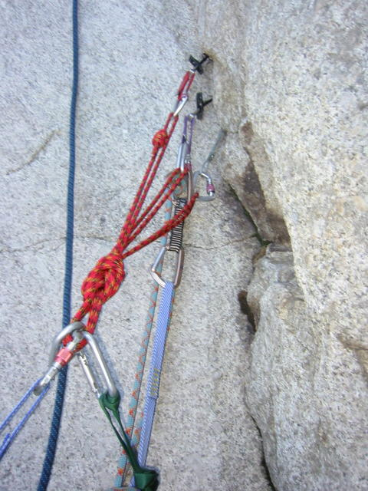
Belay
To anchor safely to the mountain either by clipping on to a piton or by fixing the rope to an actual rock feature

Slide 16
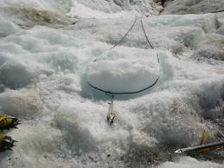
Bollard
In mountaineering, a post of ice and snow dug out to provide a belay stance to use with abseiling

Slide 17
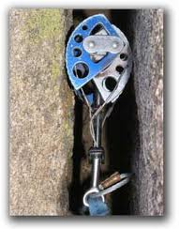
Cam
A metal spring-loaded expanding device used to provide anchor points in rock cracks

Slide 18
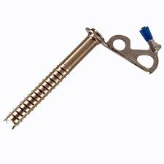
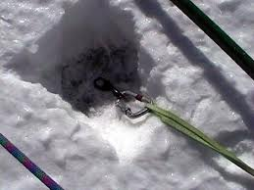
Ice Screw
Metal piton for use in ice

Slide 19
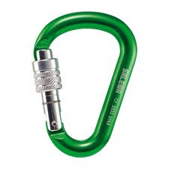
Karabiner
An oblong ring, which, when fastened to a piton, holds a rope and functions as part of a belay anchor

Slide 20
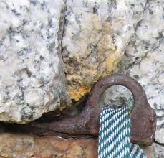
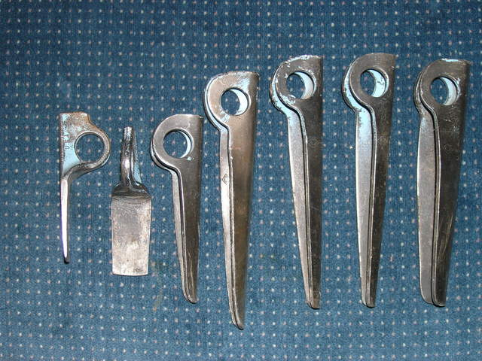
Piton
A spike of metal with an eye. It is driven into cracks in the rock and threaded for use as a belay.

Slide 21
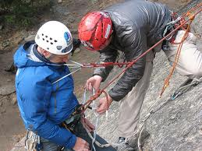
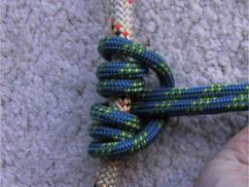
Prussik Knot
A special friction knot used for climbing a fixed rope; can be slid freely up the rope but locks to support weight of a downward force

Slide 23
Mountain Topography Terminology

Slide 24
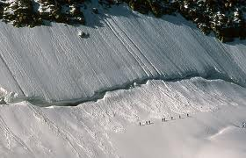
Bergschrund
A deep crevasse or series of crevasses that lie across the bottom of a snow, ice, or rock slope

Slide 25
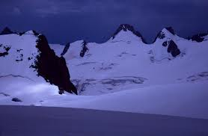
Col
A gap or depression linking two mountains or two high points on the same mountain

Slide 26
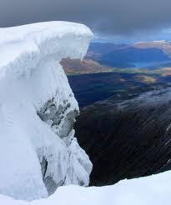
Cornice
In mountaineering, an overhanging mass of snow found on ridges

Slide 27
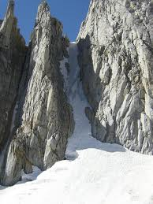
Couloir
A large funnel-like gully; often a chute for ice, snow, and stones falling from above

Slide 28
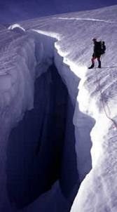
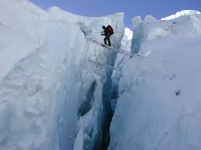
Crevasse
A fissure (or crack) in the ice

Slide 29
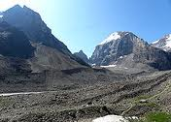
Moraine
Accumulations of boulders, rocks, and other debris either carried on or in or left behind by a glacier

Slide 30
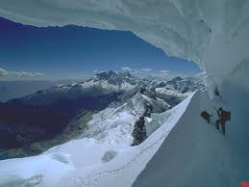
Serac
An ice cliff or pinnacle usually formed by glacier movement on mountain faces

Slide 31
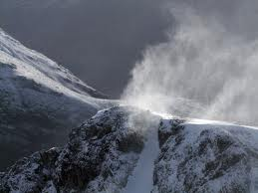
Spindrift
In mountaineering, fine powdery snow that falls of the mountain during and after a snowfall

Slide 32
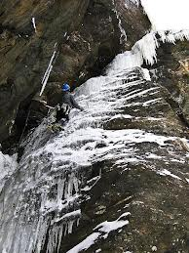
Verglas
A thin layer of ice covering all holes and cracks on the rock; very dangerous for mountain climbers

